Slide 1
SQL Structured Data Language
Date: 03.11.2014 Daniel Popa

Slide 2
Topics
Introduction
DDL vs. DML
Data QUERY (SELECT Clause)
Constraints
Data Filtering & Ordering (WHERE, ORDER BY)
Retrieving data from multiple tables
Views
Single row & group functions
Generating DB structure using Liquibase

Slide 3
Introduction
1

Slide 4
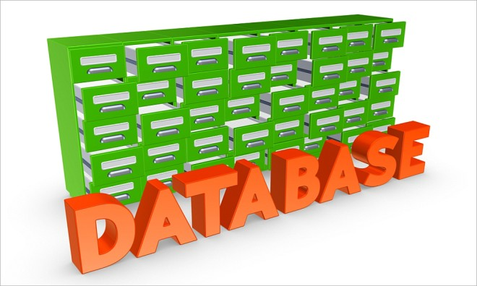
Introduction
What is a database?
A database is a collection of data that is
organized so that its contents can easily be
accessed, managed, and updated.

Slide 5
Introduction
What is a relational model?
RDBMS – Relational DataBase Management System
A collection of objects and relations that stores data. In our case this is represented by tables, organized in rows and columns.
A set of operations that acts on the relations to create other relations
Assures data integrity for accuracy and consistency

Slide 6
Introduction
In the workshop, we will work with Oracle Database.
You should already have a Docker image with Oracle XE (eXpress Edition).
We will connect to the database using IntelliJ IDEA.
Oracle Database works with users, schemas and grants. We will create our own user, grant him permissions and work only with our user afterwards.

Slide 7
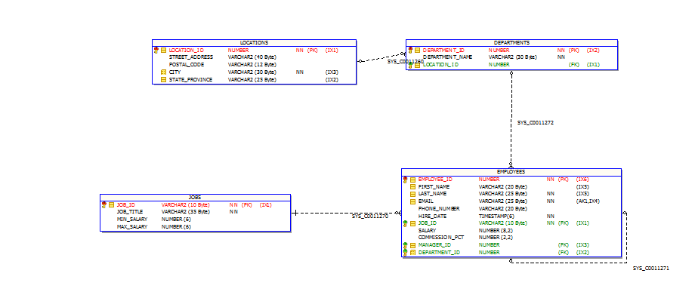
Introduction
What is a relational model?
RDBMS – Relational DataBase Management System
A collection of objects and relations that stores data. In our case this is represented by tables, organized in rows and columns.
A set of operations that acts on the relations to create other relations
Assures data integrity for accuracy and consistency

Slide 8
DDL vs. DML
2

Slide 9
DDL – Data Definition Language
What is a Data Definition Language?
A data definition language or data description language (DDL) is a syntax similar to a computer programming language for defining data structures, especially database schemas.
The Data Definition Language (DDL) is used to create and destroy databases and database objects.

Slide 10
DDL – Data Definition Language
The CREATE TABLE statement is used to create a table in a database. Tables are organized into rows and columns; and each table must have a name.
SQL CREATE TABLE Syntax
CREATE TABLE table_name(
column_name1 data_type(size),
column_name2 data_type(size),
column_name3 data_type(size));
column_name - names of the columns of the table.
data_type - type of data the column can hold (varchar2, number, date, etc.).
size parameter - maximum length of the column of the table.

Slide 11
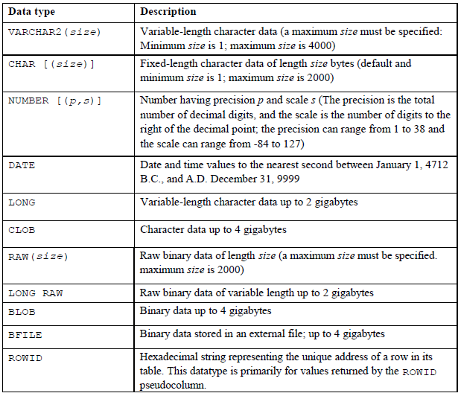
DDL – Data Definition Language

Slide 12
DDL – Data Definition Language
The ALTER TABLE statement is used to add, delete, or modify columns in an existing table.
SQL ALTER TABLE Syntax
ALTER TABLE tbl_name ADD column_name datatype
ALTER TABLE tbl_name DROP COLUMN column_name
ALTER TABLE tbl_name MODIFY COLUMN column_name datatype

Slide 13
DML – Data Manipulation Language
A DML statement is executed when:
A new record is added (INSERT)
An existing record is modified (UPDATE)
A record is deleted (DELETE)

Slide 14
DML – Data Manipulation Language
The INSERT statement is used to insert new records in a table.
SQL INSERT INTO Syntax
INSERT INTO table_name
VALUES (value1,value2,value3,...);
INSERT INTO table_name (column1,column2,column3,...)
VALUES (value1,value2,value3,...);

Slide 15
DML – Data Manipulation Language
The UPDATE statement is used to update existing records in a table.
SQL UPDATE Syntax
UPDATE table_name SET column1=value1,column2=value2,... WHERE some_column=some_value;
The DELETE statement is used to delete rows in a table.
SQL DELETE Syntax
DELETE FROM table_name WHERE some_column=some_value;

Slide 16
Data QUERY (SELECT Clause)
3

Slide 17
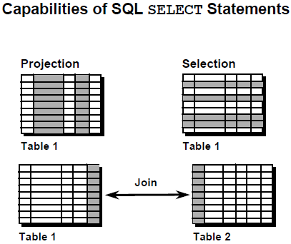
SELECT Clause
Projection: Capability of choosing the
columns from a table that will be
retrieved by the syntax SELECT SQL.
Selection: Capability of choosing the
rows that will be retrieved from a query.
Join: Capability of combining data
from many tables by creating
connections between the tables (JOIN).

Slide 18
SELECT Clause
The SELECT statement is used to select data from a database.
SQL SELECT Syntax
SELECT column_name1, column_name2
FROM table_name;
SELECT * FROM table_name;
You can also use aliases for tables and columns:
SELECT table_alias.column_name1 [AS] alias_column
FROM table_name table_alias;

Slide 19
Constraints
4

Slide 20
Constraints
SQL constraints are used to specify rules for the data in a table.
If there is any violation between the constraint and the data action, the action is aborted by the constraint.
Constraints can be specified when the table is created (inside the CREATE TABLE statement) or after the table is created (inside the ALTER TABLE statement).

Slide 21
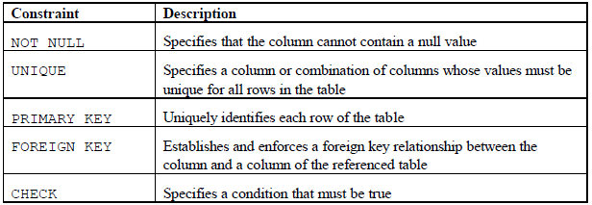
Constraints

Slide 22
Data Filtering & Ordering (WHERE, ORDER BY)
5

Slide 23
WHERE Clause
The WHERE clause is used to extract only those records that fulfill a specified criterion.
SQL WHERE Syntax
SELECT column_name1, column_name2 FROM table_name WHERE column_name1 operator value;

Slide 24
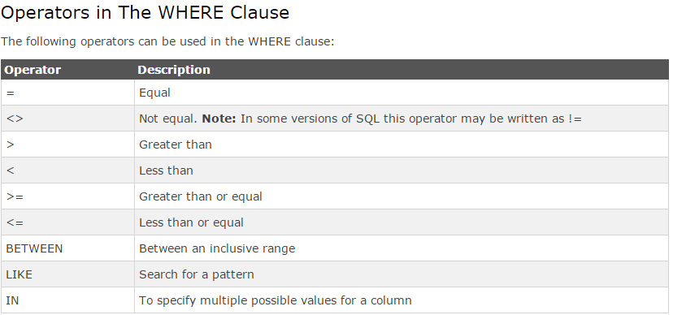
WHERE Clause

Slide 25
ORDER BY
The ORDER BY keyword is used to sort the result-set by one or more columns.
The ORDER BY keyword sorts the records in ascending order by default. To sort the records in a descending order, you can use the DESC keyword.
SQL ORDER BY Syntax
SELECT column_name1,column_name2 FROM table_name ORDER BY column_name1,column_name2 ASC|DESC;

Slide 26
Retrieving data from multiple tables
6

Slide 27
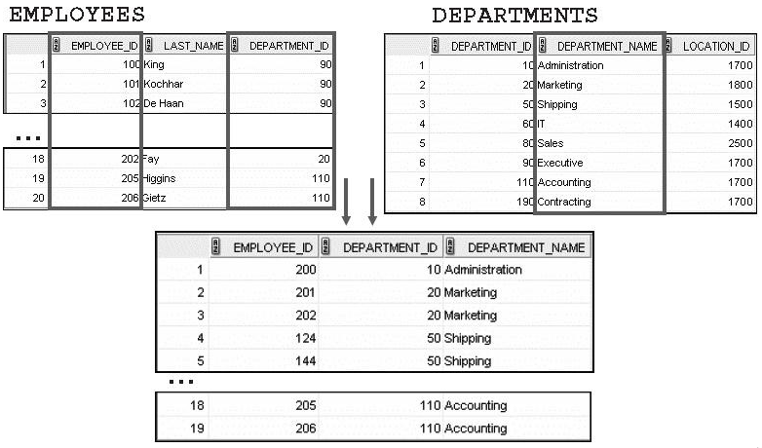
Data from multiple tables

Slide 28
SQL Joins
An SQL JOIN clause is used to combine rows from two or more tables, based on some condition.
The general syntax is:
SELECT *
FROM table1 t1
[CROSS/INNER/LEFT/RIGHT/FULL OUTER] JOIN table2 t2 [ON t1.column2 = t2.column3]

Slide 29
SQL Joins
CROSS JOIN – returns a cross product between all rows from both tables. The ON clause does not exist or does not restrict the query in any way.
INNER JOIN - returns all rows from multiple tables where the join condition is met.
LEFT (OUTER) JOIN - returns all rows from the left table (table1), with the matching rows in the right table (table2). The result is NULL in the right side when there is no match.
RIGHT (OUTER) JOIN - returns all rows from the right table (table2), with the matching rows in the left table (table1). The result is NULL in the left side when there is no match.
FULL OUTER JOIN - returns all rows from the left table (table1) and from the right table (table2). It matches rows based on the join condition and NULL for the unmatched rows.

Slide 30

SQL Joins

Slide 31
SQL Joins
In general, you should avoid cross joins since they are usually indicative of bugs.
In order to avoid them, make sure:
You have a valid join condition
You did not join multiple tables by mistake

Slide 32
Views
7

Slide 33
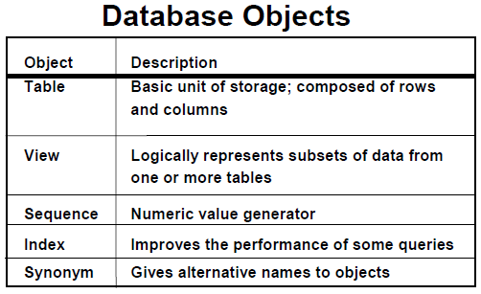
Views

Slide 34
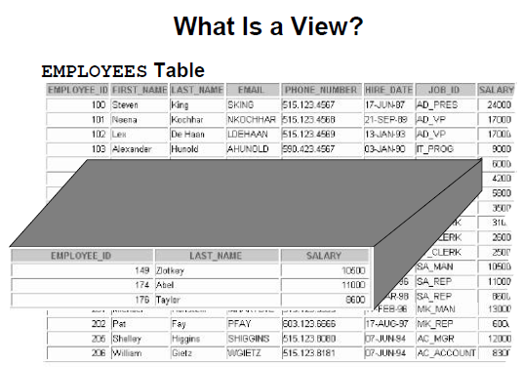
Views

Slide 35
Views
In SQL, a view is a virtual table based on the result-set of an SQL statement.
A view contains rows and columns, just like a real table. The fields in a view are fields from one or more real tables in the database.
You can add SQL functions, WHERE and JOIN statements to a view and present the data as if the data were coming from one single table.

Slide 36
Views
SQL CREATE VIEW Syntax
CREATE VIEW view_name AS
SELECT column_name(s)
FROM table_name
WHERE condition
A view always shows up-to-date data! The database engine recreates the data, using the view's SQL statement, every time a user queries a view.

Slide 37
Single row & group functions
8

Slide 38
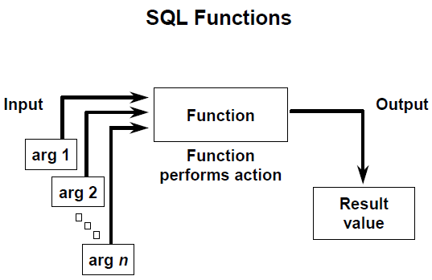
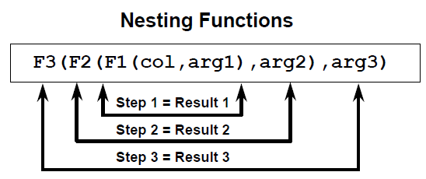
Single row functions
What are single row functions?
Are manipulating data
Accept arguments and return a single value
Act on each row
Retrieve a single result per each record
Can be nested
Arguments can be table columns or expressions

Slide 39
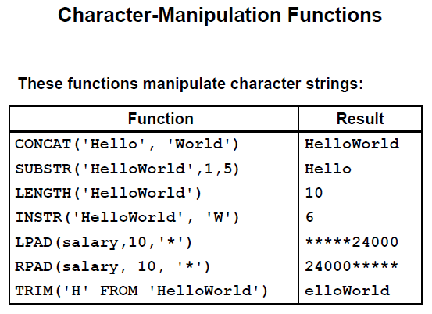
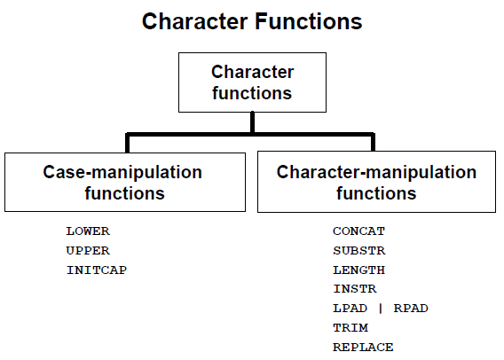
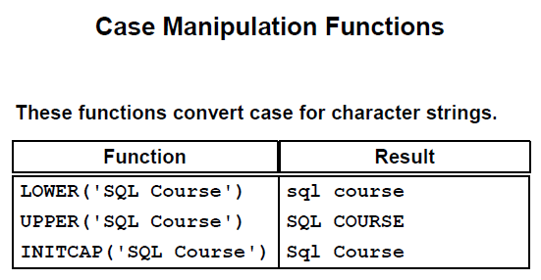
Single row functions

Slide 40

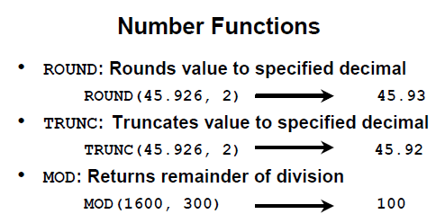
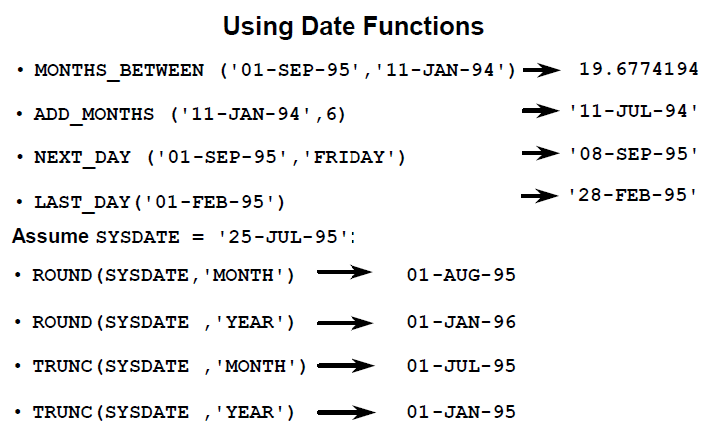

Single row functions

Slide 41
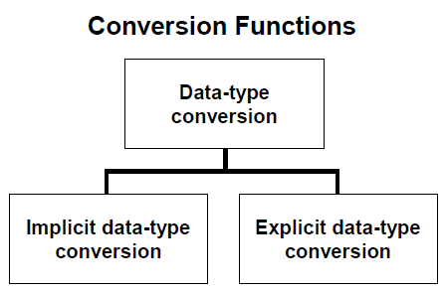
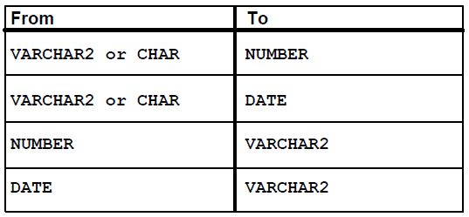
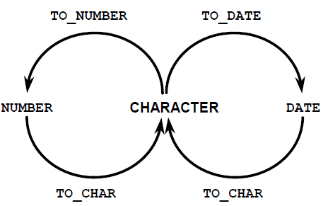
Single row functions

Slide 42
GROUP BY Clause
The GROUP BY clause is used to do operations on groups of rows
SQL GROUP BY Syntax
SELECT column_name1, MAX(column_name2) FROM table_name GROUP BY column_name1;
SQL will partition the query based on the columns in the GROUP BY clause and operate the group function on the rest of the selected columns

Slide 43
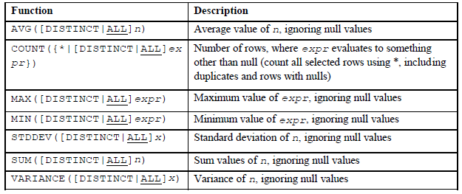
Single group functions

Slide 44
Generating DB structure using Liquibase
9

Slide 45
What is Liquibase?
Liquibase is a migration management tool for relational databases. It creates a version history for DDL and DML in a database; similar to the way Git or SVN works for source code.

Slide 46
Why Liquibase?
Uses a distributed locking system to only allow one process to update the database at a time (databasechangeloglock);
Keeps a list of all the statements that have been run against the database (databasechangelog);
Work with branches;
Supports all database types: MySQL, PostgreSQL, Oracle, DB2, etc;

Slide 47
How to use Liquibase?
Maven plugin added in pom.xml;
Directory structure: resources/db/changelog;
File db.changelog-master.xml;
Files which will be included in db.changelog-master.xml, example: db.changelog-1.0.xml;

Slide 48
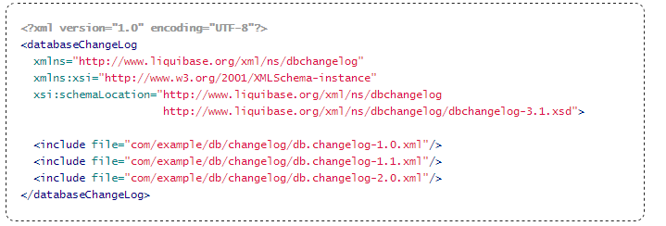
db.changelog-master.xml

Slide 49
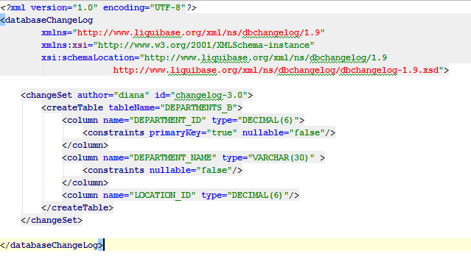
db.changelog-1.0.xml

Slide 50
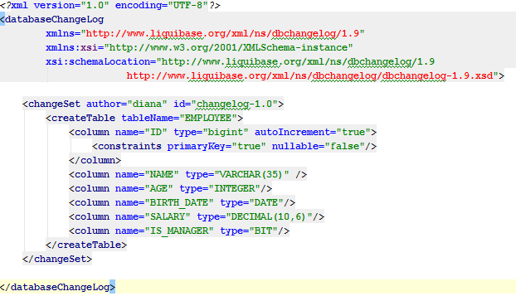
DDL in Liquibase

Slide 51
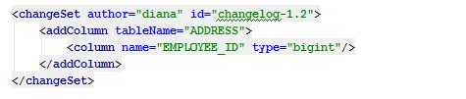
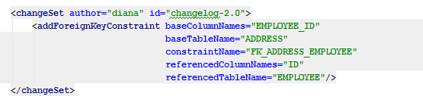
DDL in Liquibase

Slide 52

DDL in Liquibase

Slide 53
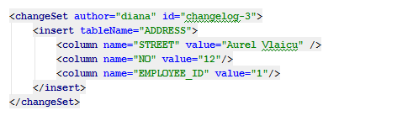
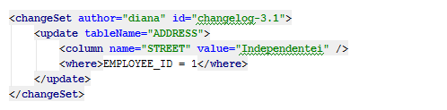
DML in Liquibase

Slide 54
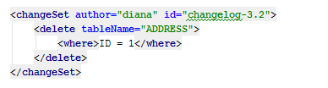
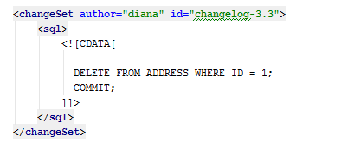
DML in Liquibase

Slide 55
Thank you!

